Slide 1
Selling Smells
Cat Rushmore
Chemicals in the British Home, 1930s-1980s
Oxford Brookes University
Science Museum

Slide 2
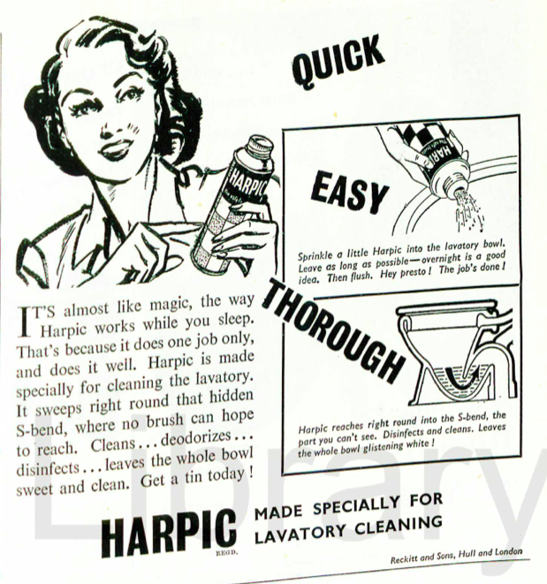

Slide 3
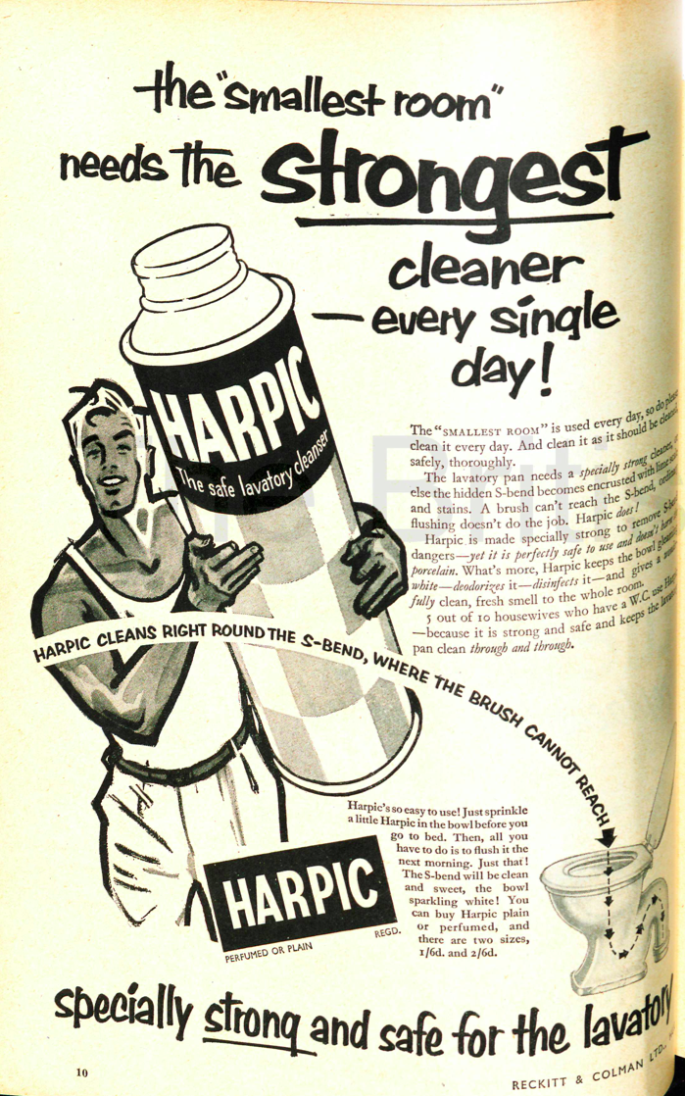

Slide 4
